Slide 1
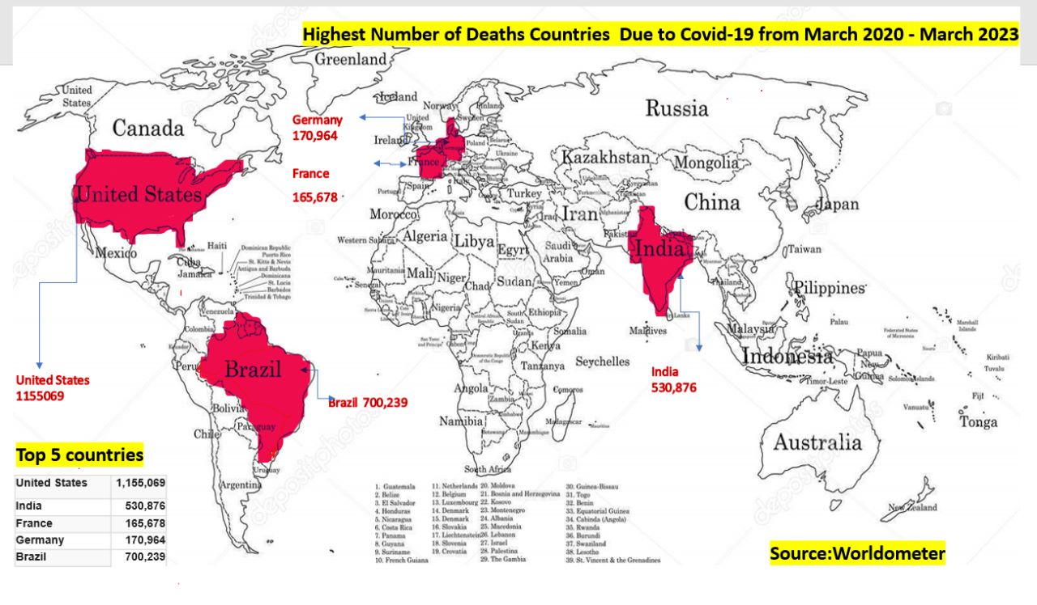



COVID-19 SURVEILLANCE DASHBOARD
2020-2023
Source: ourworldindata.org
Source: Google images
Source: Kaggle,covid-19 dataset 2022
Source: Kaggle,covid-19 dataset 2021-2022
Source: Data.CDC.Gov

